Slide 1
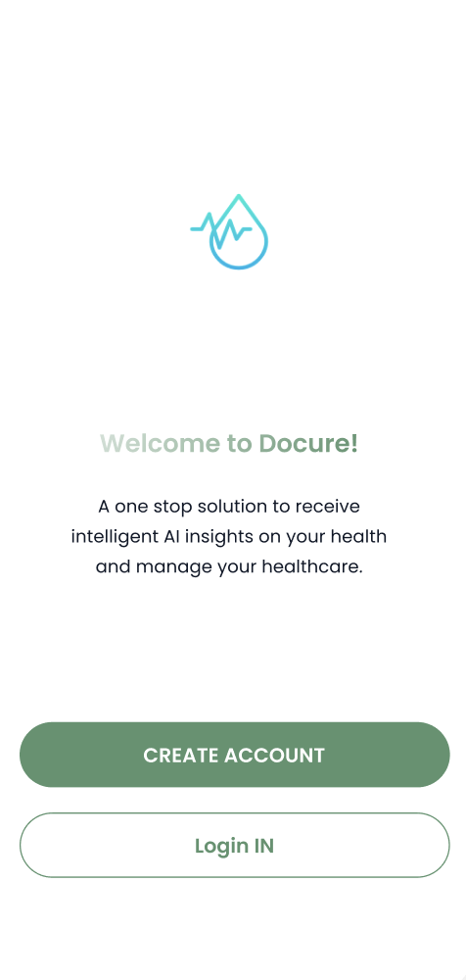
Docure
The innovative medical & health records app that has
all of your healthcare solutions at your fingertips.

Slide 2
About Application
The product, Docure, is an Electronic Medical Record System that will serve multiple functions for both hospitals and patients. Ultimately we want to create a :
Immersive platform to which hospitals can manage their EMR records and appointments
Patients can book appointments, get wellness advice, and AI-generated insights on their medical data.

Slide 3
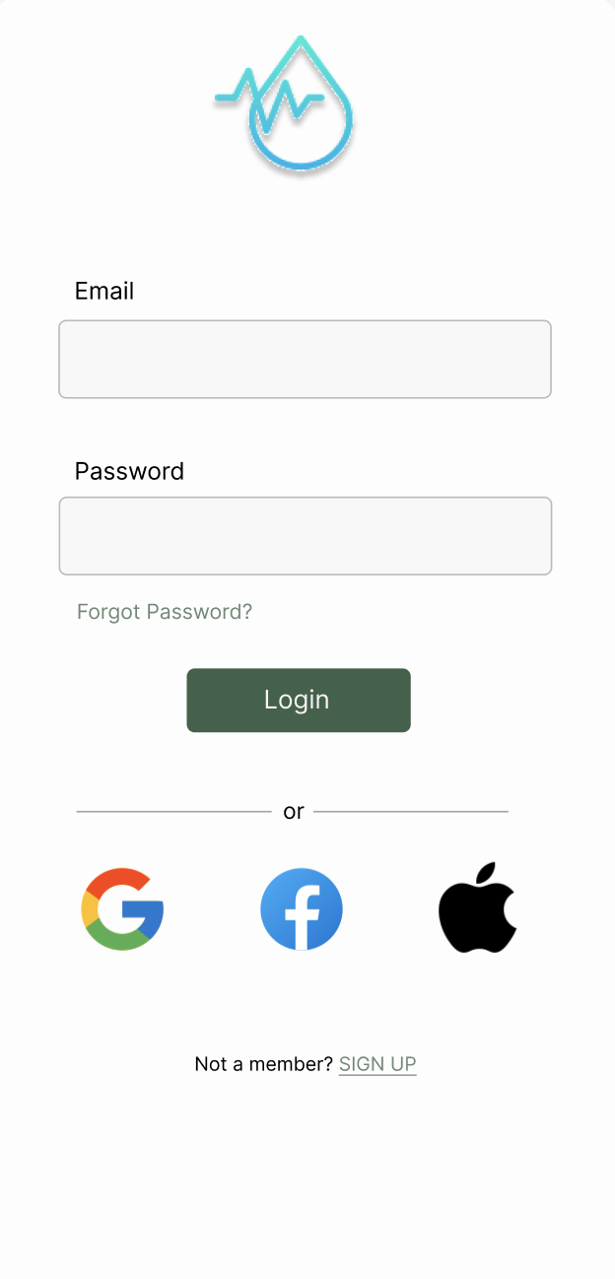
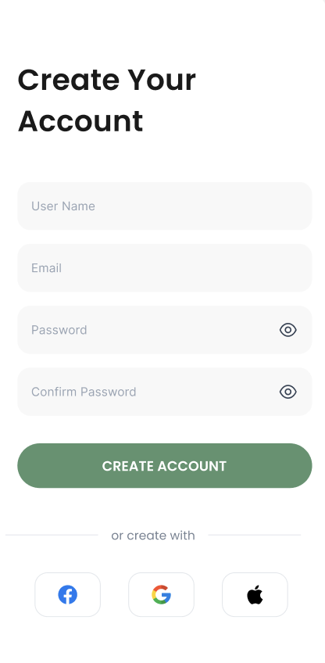
Creating a User Profile
Users will create an account by using their Google account, facebook, or email.
The application will ask you to sign-in everytime you open the app, if you are new user you need to sign up first.

Slide 4
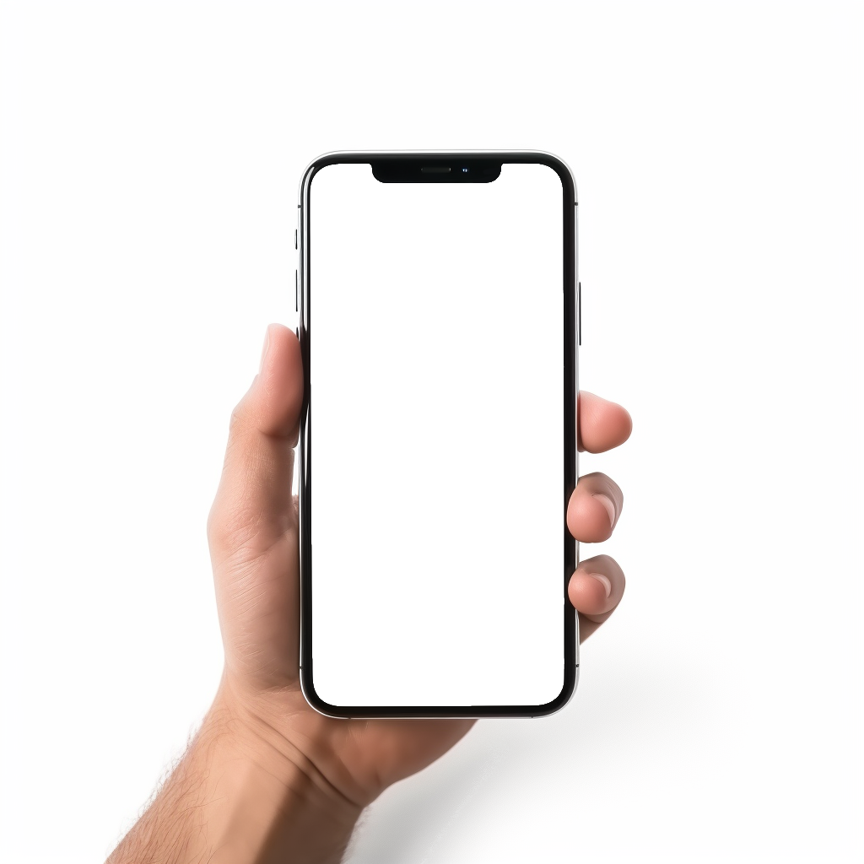
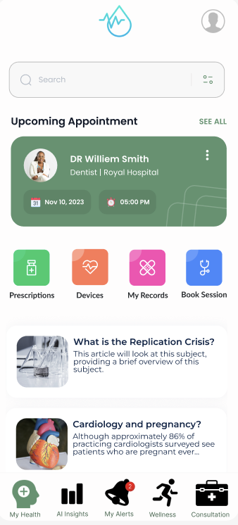

Homepage
On our homepage, you will be able to see your upcoming schedule on the top of your screen, as well as our main features right below.
You are able to book appointments, monitor your devices, and check your prescriptions and records at the touch of your fingertips.
A list of articles providing updates about trends in healthcare, and wellness.

Slide 5
Homepage
Additionally, Our app has four different main pages located at the bottom of your screen.
These pages are your health page, AI health insights that are accustomed to each User, your alerts, your wellness tracker, and lastly a consultation page.

Slide 6
Customer’s Journey
Booking appointments:
The platform empowers users with the ability to seamlessly schedule appointments with healthcare providers. This feature simplifies the often complex and time-consuming process of accessing healthcare services.

Slide 7
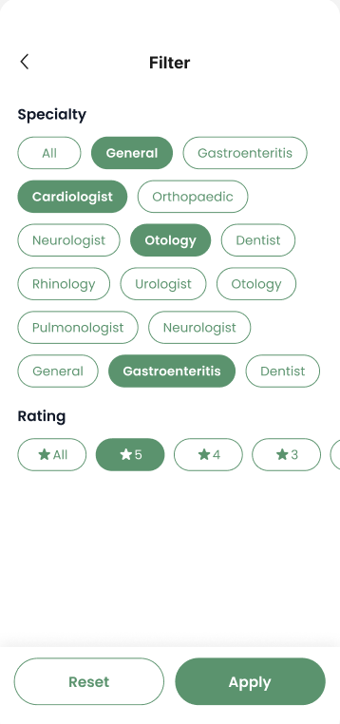
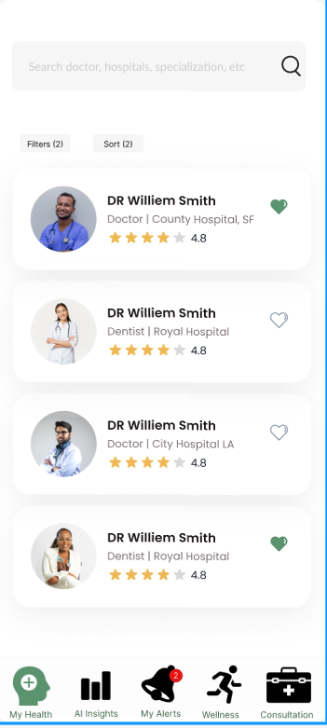
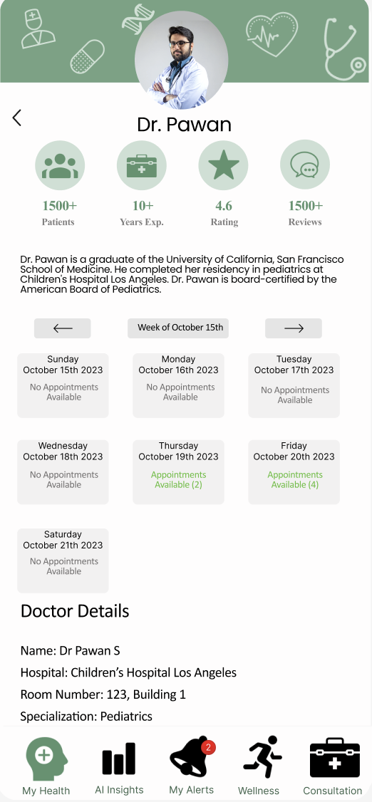
1. Users can apply filters based on speciality and ratings
2. Based on filters the app will show doctor details to book appointments
3. User book slots based on doctor’s availability and user’s suitability

Slide 8
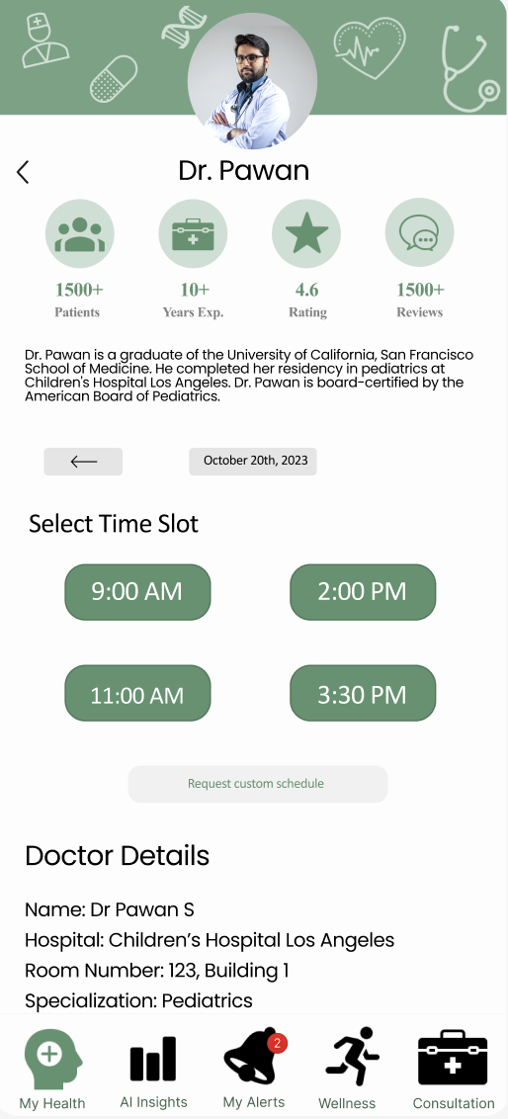
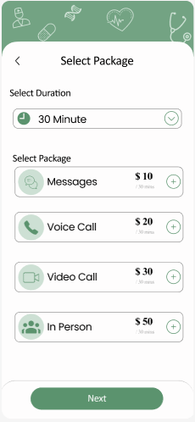
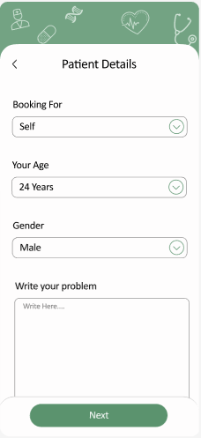
4. User chooses time slot
For appointment.
5. Users select duration and medium of the appointment
6. User fiil in their details and write about the problem

Slide 9
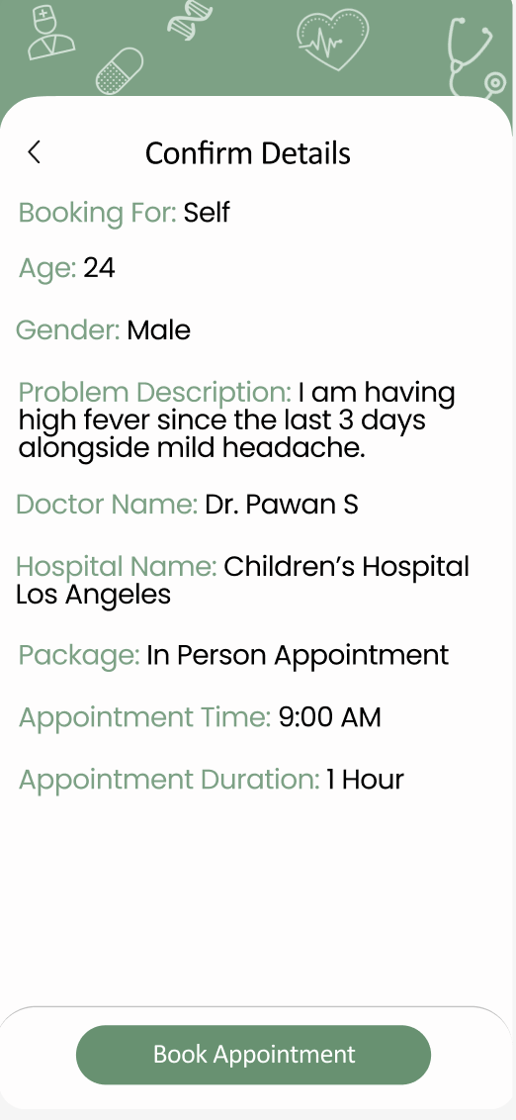
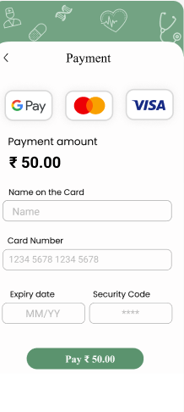
7. Users confirm their details. If there is mistake user can go back
8. User will make the payment and booking will be completed

Slide 10
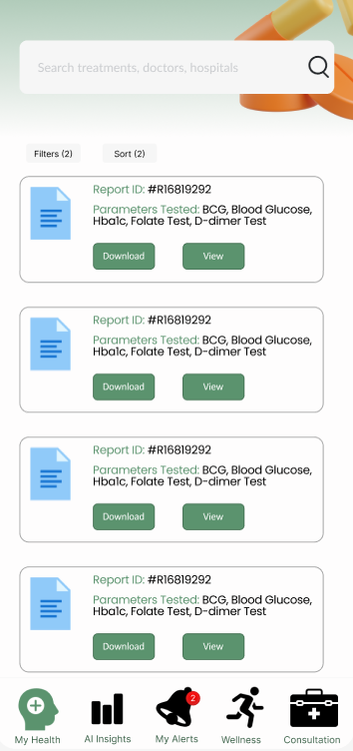
My Records
User will be able to see all of its test reports in the my records section.
It includes report id, parameters tested and allows user to view in app or download pdf

Slide 11
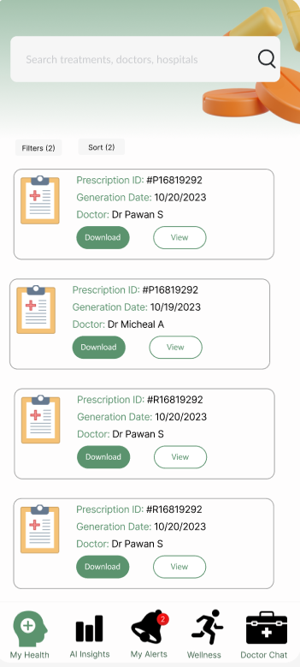
Prescription
Inside prescription tab user will be able to see all its prescription details.
Report could be viewed in app or can be downloaded in pdf format

Slide 12
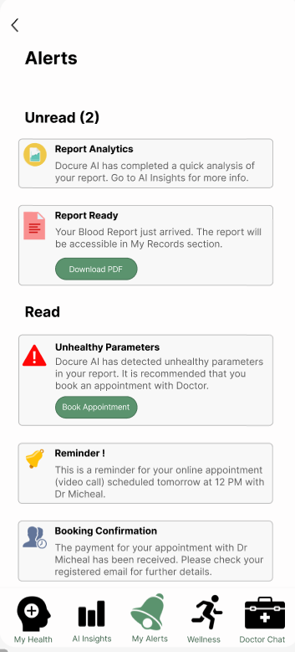
Alerts
User will be alerted for new information like confirmation of booking, appointment reminder, or any new AI insights or warning.

Slide 13
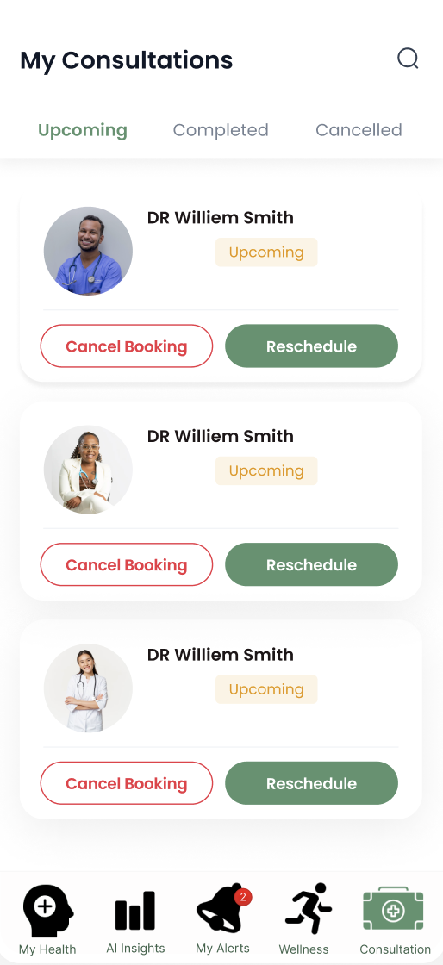
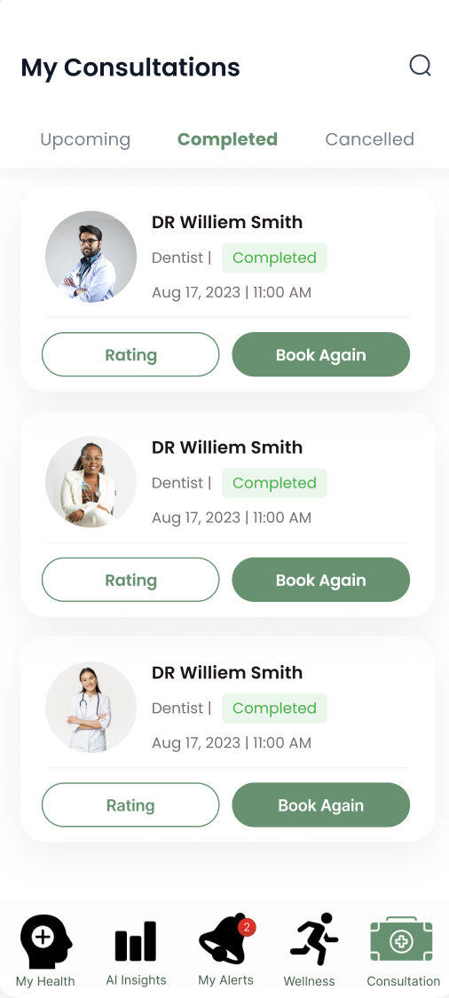
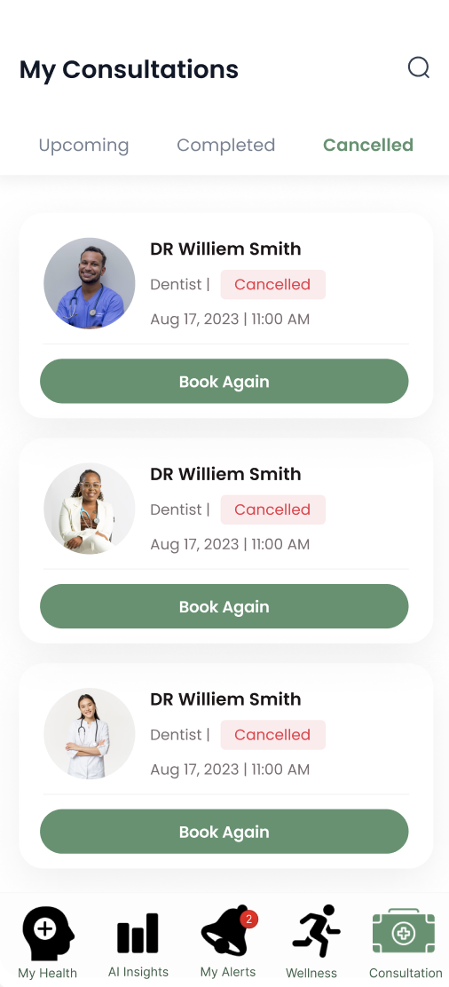
My Consultations
Users can cancel or reschedule For completed appointments, users For cancelled appointments
Upcoming appointments. can give ratings and book again users can book again.

Slide 14
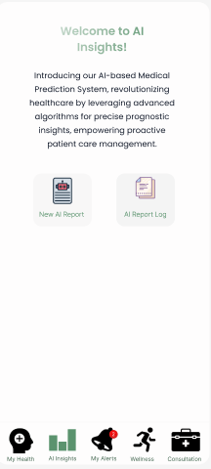
AI insights
The tab will provide insights into how you can improve your health using algorithms to figure out the solutions and converting them into small actionable pointers.

Slide 15
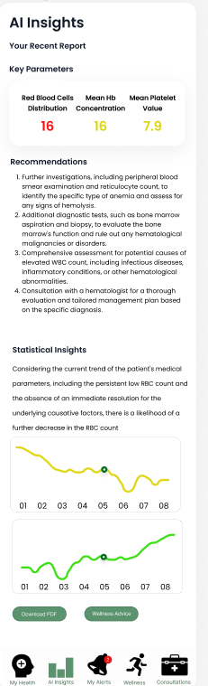
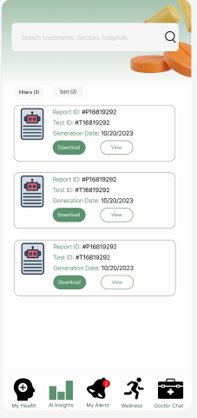
AI insights include key parameters, recommendations and statistical analysis.
It allows user to download the report and consult an expert if needed.
AI report log is also generated storing AI reports with details

Slide 16
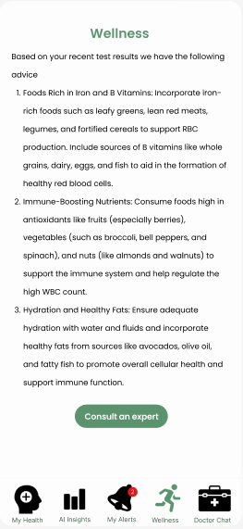
Wellness
Users of the Docure prototype also benefit from access to sample wellness advice.
Wellness advice encompasses a broad range of guidance, from lifestyle recommendations to dietary suggestions, and it encourages users to adopt a proactive stance in maintaining and enhancing their overall health.

Slide 17
Third party API Integration
By integrating with Docure, 3rd party applications like insurance company can provide users with the ability to schedule appointments, access automated insights,
and receive doctor recommendations based
on medical reports. This integration empowers third-party MedTech applications to provide a more comprehensive and patient-centric healthcare experience.

Slide 18
Technical Details
During the prototype stage, several tools and technologies were employed to create a functional model of Docure:
Project Development: JIRA and MIRO were used to develop the scrum board.
Wireframes: In the early stages of our prototype development, we employed Figma to create basic wireframes for our project.
Basic Data Security: The prototype incorporated basic encryption and security measures to protect user data, even though it was not yet fully compliant with healthcare regulations.
Testing Environments: Separate testing environments were set up to evaluate the prototype's functionality and usability.

Slide 19
Thank you!

